Slide 1
Horizon scanning: the future of mathematics teaching in HE
Tony Mann, University of Greenwich

Slide 2
A Personal VIEW
Everything I say is a personal point of view
I have not discussed this with colleagues
I don’t expect anyone to agree with me
“Prediction is very difficult, especially about the future” (Niels Bohr / Piet Hein)
I expect all my predictions to be wrong

Slide 3
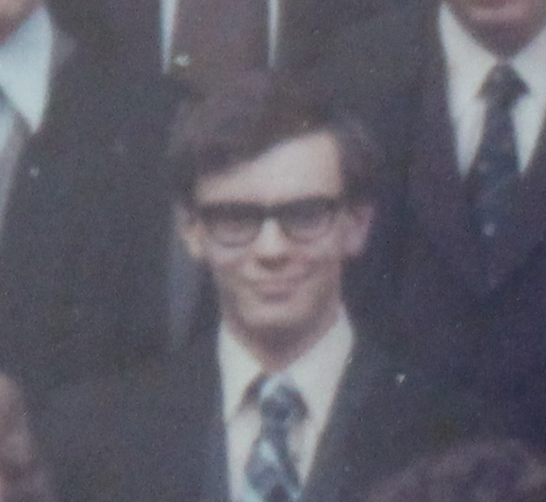
Forty years ago

Slide 4
Forty years ago
I spent twelve hours a week copying down what the lecturer wrote on the board as fast as I could
Then I went back to my room and tried to understand it
If not, I had a twenty-minute walk to the library
Where the book I needed might or might not be available

Slide 5
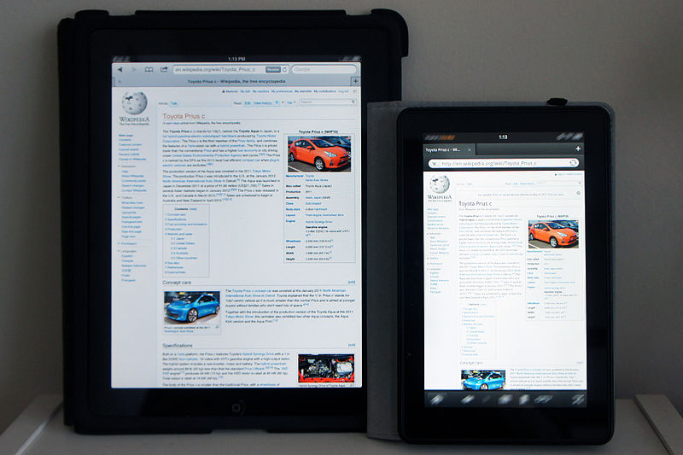
TODAY
Students can think during lectures
They can learn wherever they are with smartphone or tablet
They have Wikipedia
I spend much more time creating teaching material, mathcast feedback etc than I ever did 20 years ago
No wonder results are getting better!
Mariordo (Mario Roberto Durán Ortiz), Wikimedia Commons CC-BY-SA 3.0

Slide 6
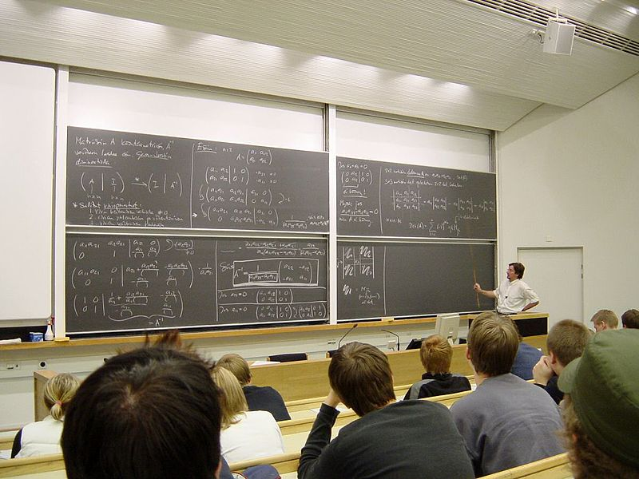
POWERpoint or blackboard?
I do mathematics with a pen in my hand
One understands maths by seeing it developed, not by going straight to the answer
Lecture capture must capture the writing, not just the end product
Digital revolution started slowly for mathematics
Tungsten,
public domain

Slide 7
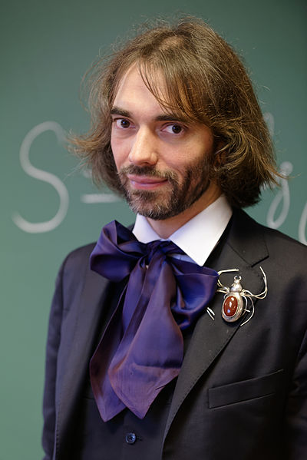
Pencil and paper?
For some, maths is still to be done on paper (see Cédric Villani, Birth of a Theorem)
(Where does electronic submission of coursework fit?)
How long can that continue in the digital age?
Marie-Lan Nguyen, Wikimedia Commons, CC BY 3.0

Slide 8
TODAY
Lecture capture
Easy for lecturer
Allows students to revisit difficult bits (not play the whole lecture)
Technical issues
Need to capture act of writing, not just PowerPoint

Slide 9
TODAY
Mathscasts
Focus on key points (short and to the point)
Time-consuming to prepare
Good for feedback
Popular with students
Can capture act of writing!
Quality issues (especially sound)

Slide 10
TODAY
Flipped Classroon
Students study material in advance
Class time spent addressing specific difficulties / doing problems
Makes demands of students and tutors

Slide 11
ASSESSMENT
I was assessed entirely by closed book exam
Emphasis on speed and right method
And memory
Performance affected by time of day, hay fever / medication, etc, etc
No relevance to real-life mathematics of any kind
But authentic!

Slide 12
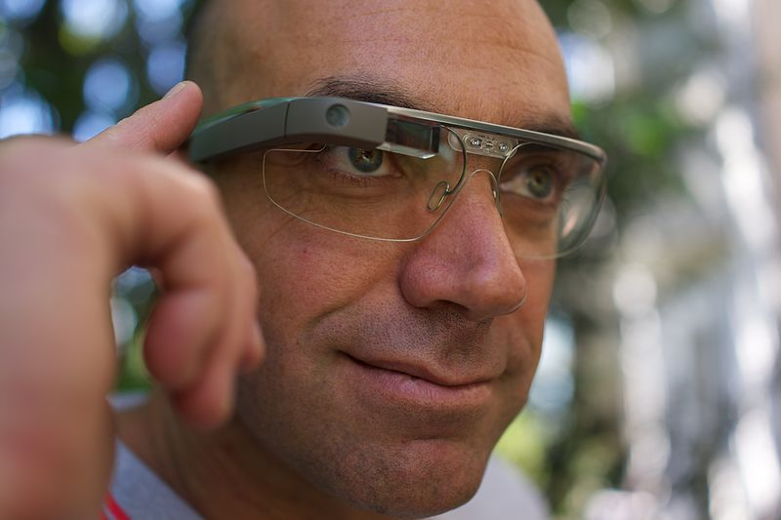
FUTURE?
With Google Glass type technology, cheating in exams will be easy
(It’s probably already much more common than we think)
So what will be the point of exams?
Loïc Le Meur, Wikimedia Commons, CC BY 2.0

Slide 13
ASSESSMENT
Students focus on assessment much more than in my time
We and students put too much time and effort into (inevitably) flawed assessment that could be better spent on teaching and learning

Slide 14
MARKING
My least favourite academic activity (by far)
Online assessment marked by computer is popular with students, offers immediate feedback, more engagement
But time-consuming to set up

Slide 15
A problem
Online assessment, mathscasts, detailed feedback, flipped classroom
Needs huge investment of time
Freezes the curriculum – because of the investment in the resources

Slide 16
Forty years ago
I did no groupwork or project work
I gave no presentations
I learned nothing to prepare me for the workplace (and arguably not to prepare me for research)

Slide 17
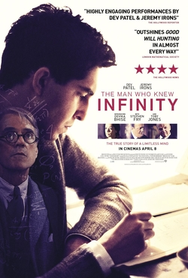
COLLABORATION
Maths is collaborative!
(Birth of a Theorem, The Man Who Knew Infinity, etc, etc)
Are we training students to collaborate?
Students don’t like assessed groupwork but they need the skills
Even if they are going to do a doctorate in pure mathematics!
Warner Bros, fair use

Slide 18
COllaboration
Technology offers new ways to collaborate (eg Polymaths)
We can use VLE interactions to assess individual contributions to group assignments
When will our students be collaborating with computer proof assistants?

Slide 19
40 YEARS AGO
I had excellent personal tutors
And no financial concerns

Slide 20
STUDENT SUPPORT
For many of our students, available funding does not cover fees + accommodation
They are under different pressures
Academics expected to provide more pastoral care
Initiatives like Maths Arcade to promote “community”

Slide 21
MY HOPES
Lectures replaced by more useful activities
Exams replaced by more useful assessment
More focus on learning, not assessment
More focus on teaching, not marking
A new golden age

Slide 22
EXCITING TIMES!
Thank you for listening!

