Slide 1
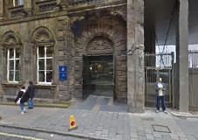
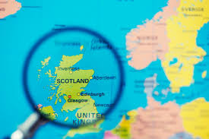
ICMS, Edinburgh
Paul Glendinning
University of Manchester
Scientific Director, ICMS

Slide 2

Vision and Roadmap
ICMS is globally recognised as a centre for short workshops in all areas of mathematical sciences and applications.
It has strong Knowledge Transfer and Public Engagement activity.
Stuff happens here, it’s not just an arena for reporting.
How do we get there?
Sustainable funding
Maintain excellence
Nimble and flexible
Strong physical and intellectual identity
Clear aims and clear delivery plan

Slide 3
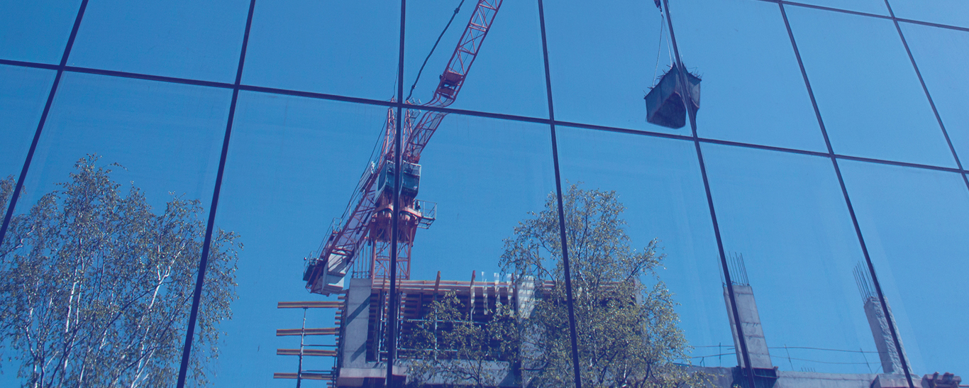

UK Mathematics Infrastructure
EPSRC Grant (current grant ends Easter 2018)
Funds administration and building [NEW from Summer 2018], and basic programme of activity
Enables twice that level of activity through other funding sources
(56% of ICMS funds from the basic grant, 35% of participant days from basic grant in 2016)
This is what infrastructure does! EPSRC Review

Slide 4
Opportunities (in next grant application)
12 open International Workshops including ECR workshops
Research in Groups (short international collaborations)
6 Capability Workshops (innovative cross disciplinary, agile, strategic, new industrial applications,…)
Research Partnerships with industry (one non-academic partner with one academic partner)
Follow on grants
KE support and contacts for maximum impact
KE community building
PE activity locally and nationally
PE training and leadership
Delivered by publicity, proactive approaches,
working with HoDoMS, INI and EPSRC .

Slide 5

Strengths
International exchange of ideas at highest level
International exposure
International reputation
Community building
Impact delivery
Great Maths
Nimble
Training for new academics (PE and KE)
50% UK-based
30% EU based
Strong record of outputs (currently compiling list of papers generated by activity)
7 Fields medallists in three years
48 UK Universities represented in past three years (53 to REF2014)
We help to enable geographical distribution of excellence in research

Slide 6
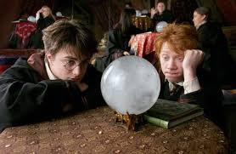
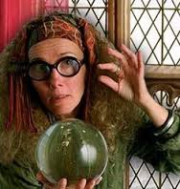
The future
Mathematics infrastructure hard to create and easy to lose (support us now!).
EPSRC strategy important e.g. Grand Challenges and Data Science (Turing) but CENTRALLY organized.
Links with EU likely to remain important – strong track record with individuals, but we should build relations with institutions as well.
Newton Fund and/or UN Global Challenges an opportunity
Women in Mathematics continues to need attention, and diversity more generally (monitor, change expectations).
Investment in and support for ECRs.
International diversity (Africa and South America, but also China and India).
Vitality of activity and international profile will remain ICMSs most powerful argument for support.

Slide 7
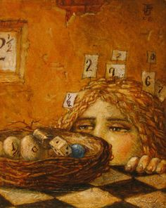
What have I missed?
How can we help the maths community persuade central university admin of the value of maths in joint projects?
How can we better advertise the opportunities at ICMS more broadly in the community?
Importance of ICMS for maintaining strong links with international colleagues.
What are we not doing that we could do?

Slide 8
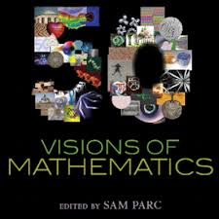
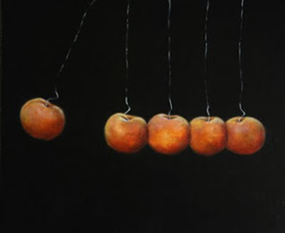
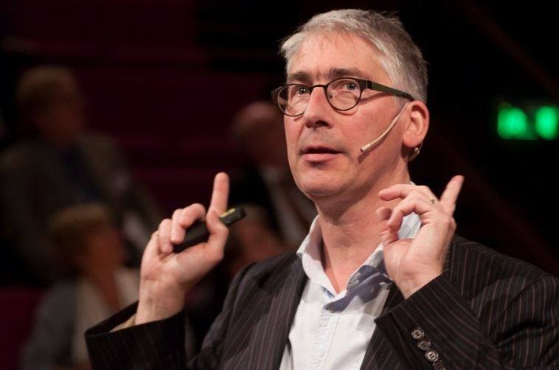
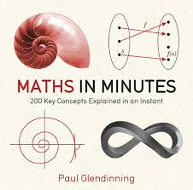
PS. If you don’t know me…
Mathematician (broad: vP of IMA, LMS Nominating Cttee, Faculty of Actuaries)
Management experience: Head of School for Manchester – UMIST merger, appointment cttees
Grant experience: EPSRC and RS committees and grants
KT experience: as an enabler
PE experience: popular books, events
Political experience: co-chaired first seminar on maths in Houses of Parliament
EU experience and friends: CRM, IHES, Max Planck, Erice, France, Germany, Spain
INI connections: IDA, Scientific Steering Cttee
New building experience: Alan Turing Building
Royal Institution 2014

