Slide 1
Co-existing with difficult colleagues
Jan van den Heuvel (LSE, HoDoM 2011–2015, 2019–…)
Based on Jeremy Levesley’s plans for this session.

Slide 2
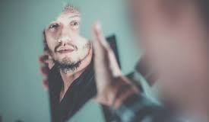
What is a difficult colleague?
What is an ideal colleague?
“different = difficult”?
Can people always control being difficult?
Does it make a difference how to deal with it?
Great people; horrible group. How to handle that?
Do you always need to act?
What form of co-existence can we live with?
To start the discussion

Slide 3
Things I (= Jeremy) have learned
Do not take things personally.
I am a casualty of other lives, not a target.
Be consistent
Do not get into personal arguments
Draw boundaries – there is unacceptable behaviour
Use processes (HR support is really important)

